Slide 1
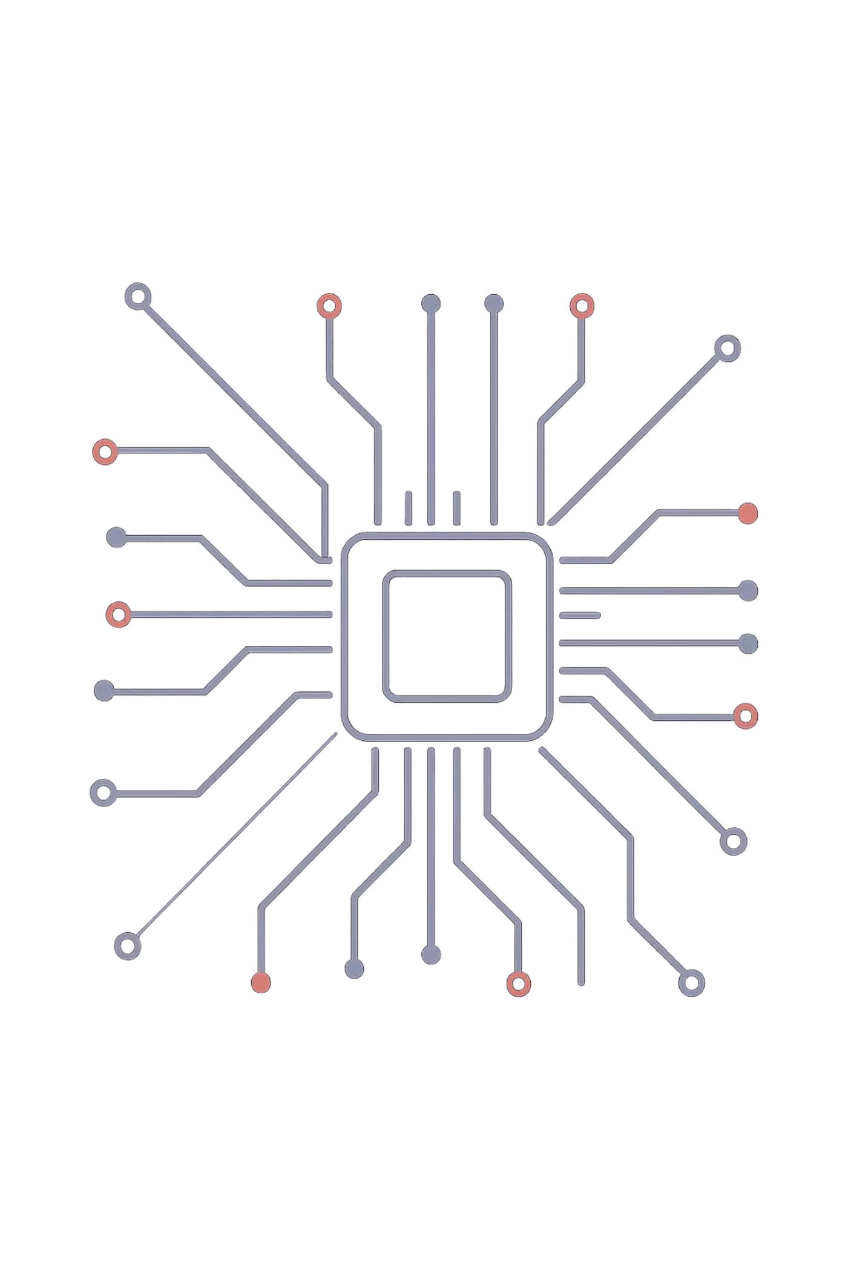
AMBA AHB: The Backbone of Modern SoCs
A deep dive into ARM's Advanced High-performance Bus — the protocol that
transformed how billions of chips communicate on a single die.
PROTOCOL DEEP DIVE
ARM AMBA

Slide 2
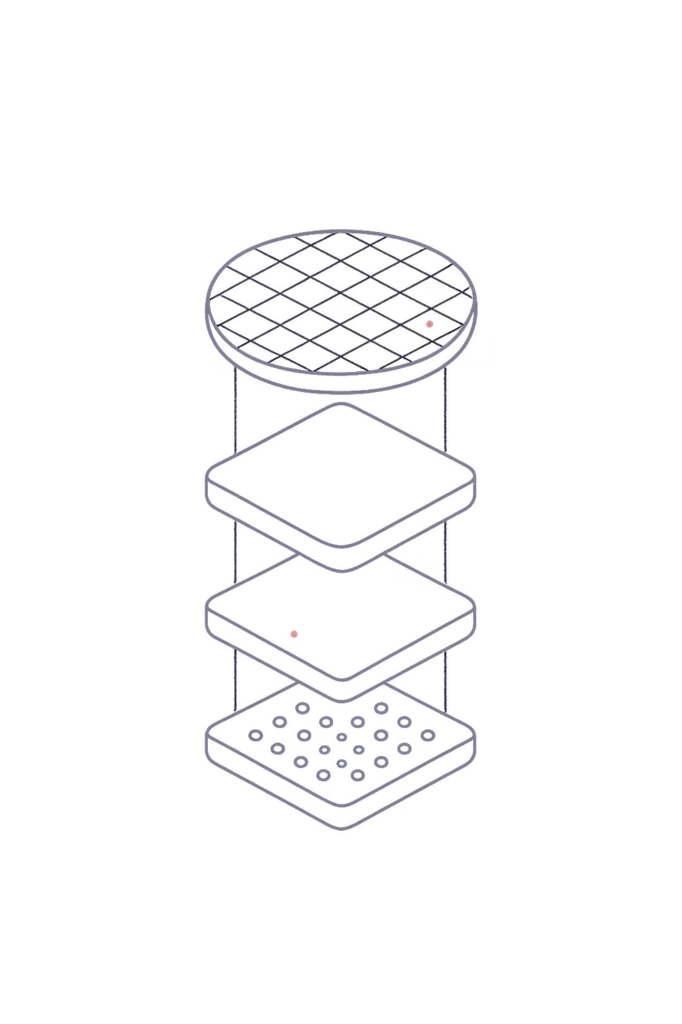
The Need for a Standard: From Microcontrollers to SoCs
Early embedded systems were elegantly simple — a single processor, a handful of peripherals, and a straightforward bus. But as silicon technology advanced, System-on-Chip (SoC) designs began integrating dozens of complex functional blocks: CPUs, GPUs, DSPs, memory controllers, and I/O interfaces — all on a single die.
The Old World
Single-processor microcontrollers with proprietary, ad-hoc interconnects. Simple, but inflexible and non-scalable.
The New Challenge
How do you efficiently connect, arbitrate, and manage dozens of diverse components on a single chip without chaos?
The Answer
A standardized, open interconnect specification that enables IP reuse, predictable performance, and right-first-time design.

Slide 3
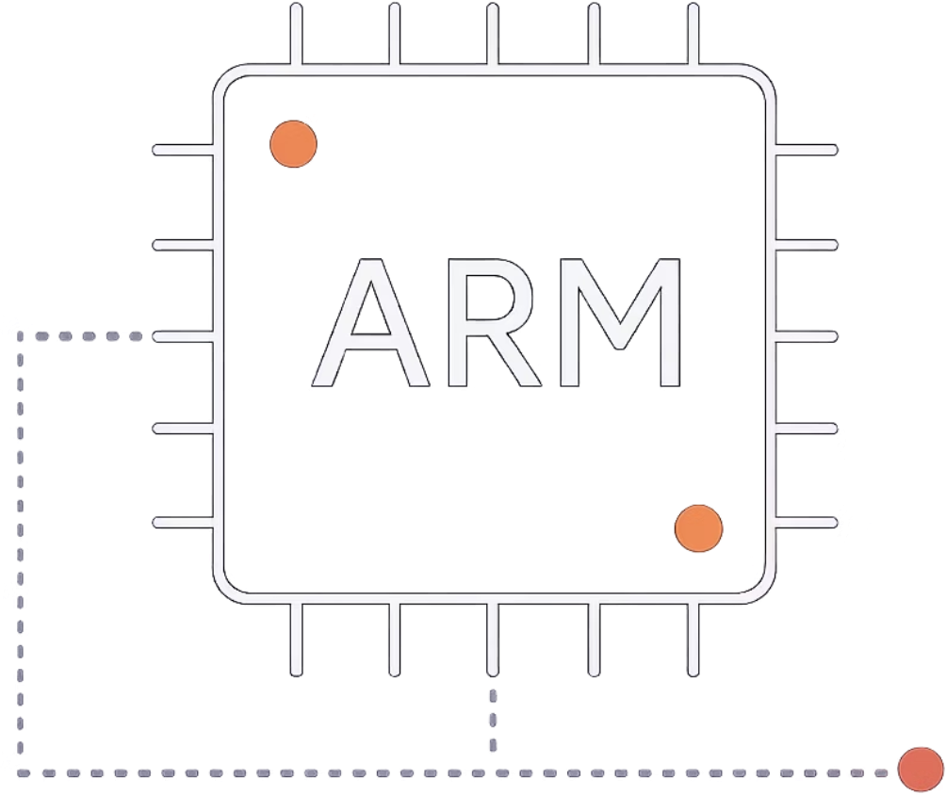
Enter AMBA: ARM's Solution for On-Chip Interconnect
What Is AMBA?
AMBA (Advanced Microcontroller Bus Architecture) is an open-standard on-chip interconnect specification introduced by ARM in 1996. It was designed to solve a fundamental problem: enabling multiple processors and peripherals to communicate efficiently within a complex SoC.
Core Objectives
Facilitate multi-processor design with clean, well-defined interfaces
Enable IP core reuse across different SoC projects and teams
Support "right-first-time" development — reducing costly silicon respins
Provide a royalty-free, well-documented specification
accessible to all licensees

Slide 4
The Evolution of AMBA: ASB, APB, and the AHB Breakthrough
AMBA didn't arrive fully formed — it evolved through deliberate iteration, with each version addressing the performance demands of its era.
1996 — AMBA 1
Introduced ASB (Advanced System Bus) for high-performance connections and APB (Advanced Peripheral Bus) for low-bandwidth peripherals. A foundational step.
Key Innovation
AHB's single-edge design eliminated the complexity of multi-clock protocols, reducing power consumption and enabling higher operating frequencies in deep-submicron processes.
1
2
3
1999 — AMBA 2 & AHB
The breakthrough: AMBA High-performance Bus (AHB) replaced ASB with a single clock-edge protocol, dramatically simplifying timing closure and boosting throughput.

Slide 5
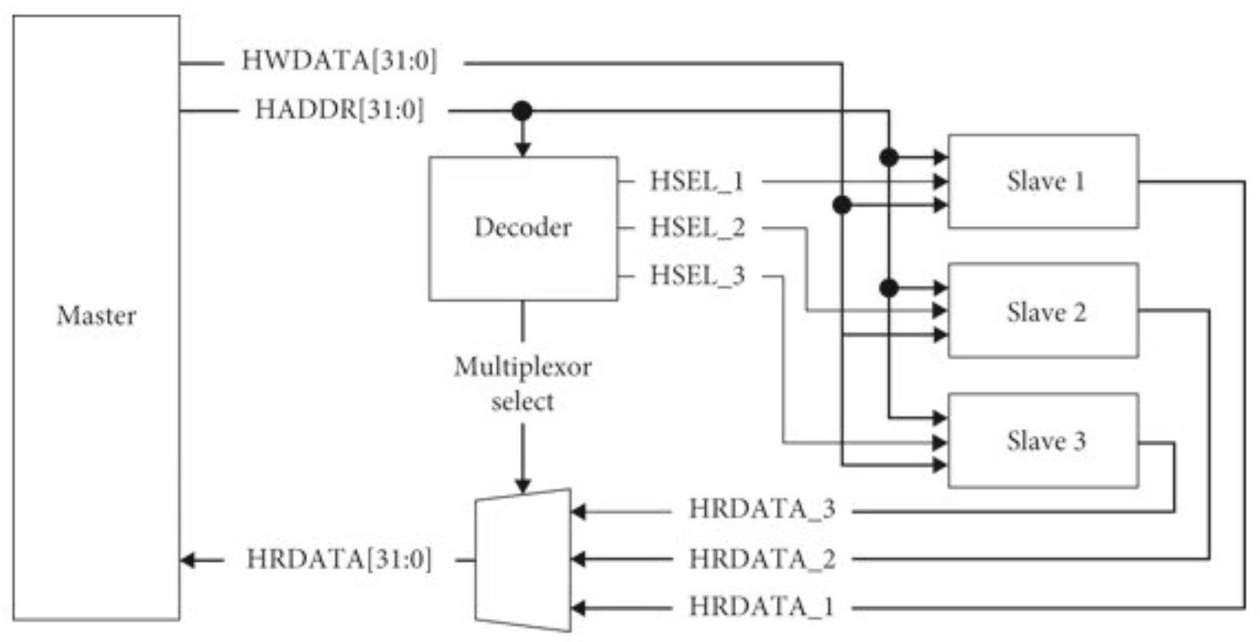



AMBA AHB: High-Performance, Master-Slave Architecture
AHB was designed for system-level, high-bandwidth connections — the critical pathways between processors, memory and other components
Masters
Slaves
Pipelining
Components that initiate read and write transactions. Examples include CPUs, DMA controllers, and USB host controllers. Multiple masters can exist on a single AHB bus.
Components that respond to master requests. Examples include SRAM, Flash memory, peripheral controllers, and register banks. Each slave occupies a defined address map region.
AHB supports pipelined transfers — a new address phase can begin before the previous data phase completes, overlapping operations to maximize bus utilization and throughput.

Slide 6
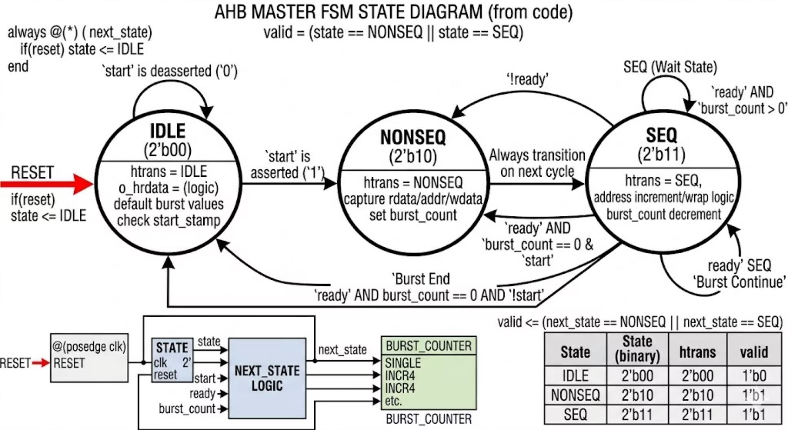
AHB STATE
IDLE State
Indicates no valid transfer
Bus is inactive (no data/address phase)
Used when Master doesn’t want to use
the bus
Slave ignores signals in this state
NONSEQ (Non-Sequential) State
Indicates start of a new transfer
Address is not related to previous transfer
Used for First transfer
SEQ (Sequential) State
Indicates continuation of a burst transfer
Address is sequentially related warpped
or incremented

Slide 7
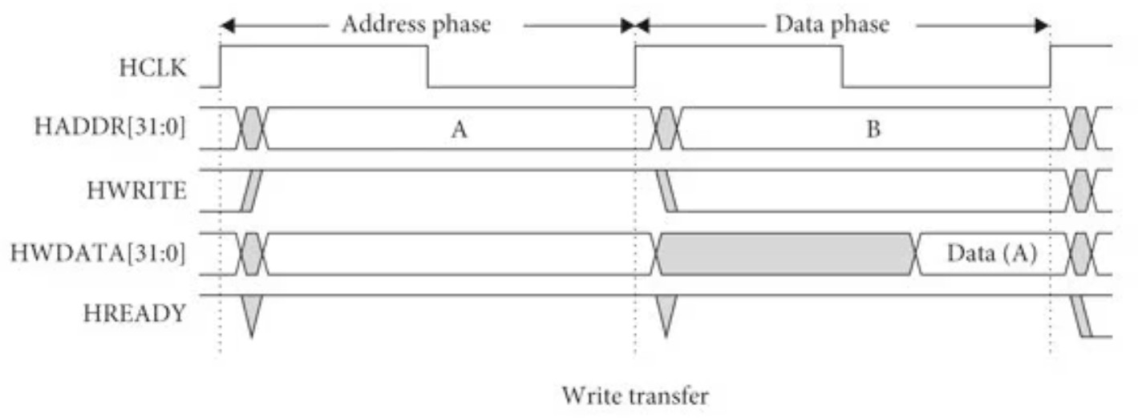
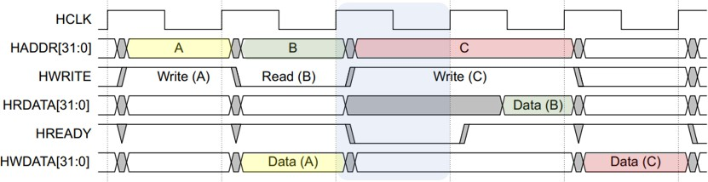
AHB Data Transfer Phases
Address Phase
Address location ,Type of transfer, Size and burst
information
Used to inform the slave about the upcoming operation
Address phase of next transfer can overlap with
current data phase (pipelining)
Slave interprets and prepares for the operation in this phase
Data Phase
Follows the address phase
Actual data transfer takes place
May take multiple clock cycles depending
on slave readiness
Includes status/response information
Transfer completes only when the system indicates
ready/valid condition

Slide 8
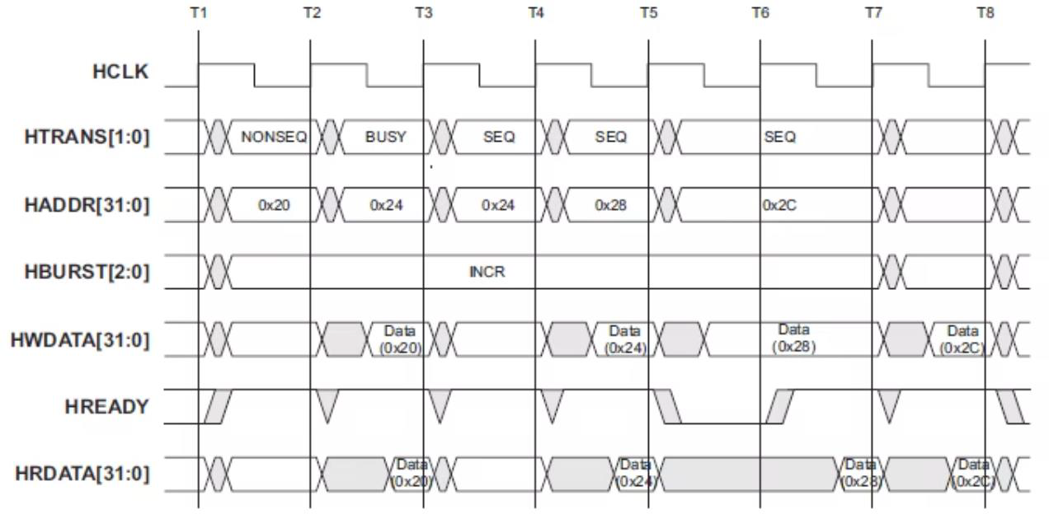
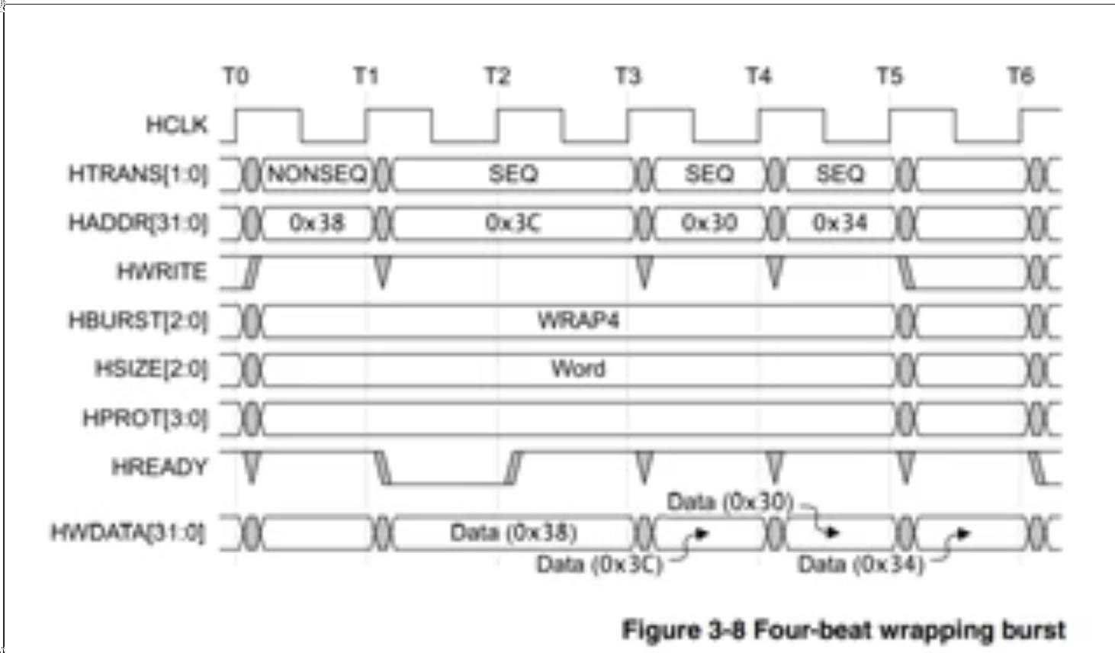
Key AHB Features for Efficient Data Transfer
1
SINGLE Transfer
Only one data transfer
No burst involved
Each transfer is independent
2
INCR (Incrementing Burst)
Address increments after each transfer
Length can be:
Undefined (INCR) → continues until master stops
fixed length (like INCR4, INCR8, INCR16)
Used for continuous memory access
3
WRAP Burst
Address increments but wraps around at boundary
Fixed sizes:
WRAP4, WRAP8, WRAP16
Used in:
Cache line fills
Address stays within a fixed boundary

Slide 9
AHB-Lite: A Simpler, Efficient Subset
Not every design needs the full complexity of AHB. For simpler embedded systems — single-master configurations, microcontrollers, and cost-sensitive ASICs — ARM introduced AHB-Lite, a streamlined subset that retains the protocol's core strengths.
What AHB-Lite Keeps What AHB-Lite Removes
Single clock-edge operation
Pipelined address/data phases
Burst transfer support
Same signal naming and timing model
Full backward compatibility with AHB slaves
Multi-master arbitration logic
Split transaction support
LOCK signal (atomic access)
Burst type wrap mode
Some optional error response signals
The result: a lighter, easier-to-integrate bus that still delivers AHB-
class performance for single-master designs.

Slide 10
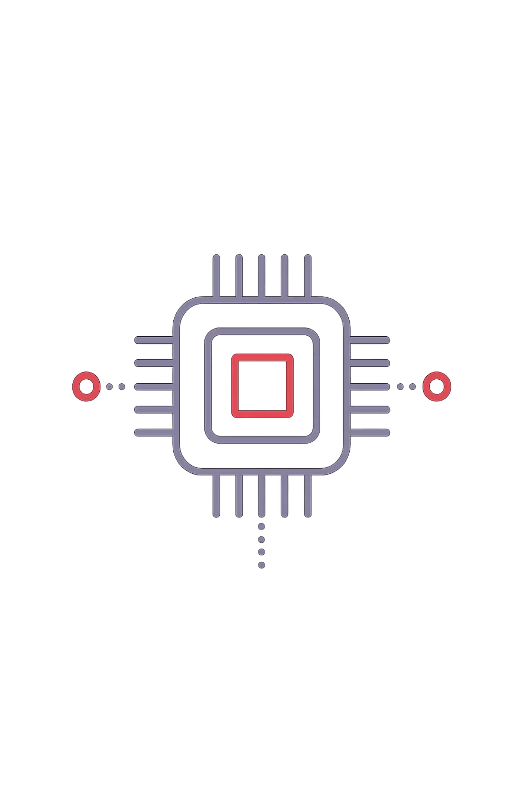
AHB's Impact: The De Facto Standard
AHB didn't just become popular — it became ubiquitous. From low-power microcontrollers to high-end application processors in smartphones, AHB and its successors define how on-chip components communicate across the entire embedded spectrum.
1999
Year Introduced
AHB debuted over two decades ago and remains relevant in modern SoC designs today.
25+
Years of Adoption
Quarter-century of continuous use across billions of shipped devices worldwide.
0
Royalty Cost
AMBA specifications are royalty-free, accelerating adoption and ecosystem growth.
1000s
SoC Designs
Used in ASICs and SoCs spanning microcontrollers, automotive, IoT, and mobile processors.

Slide 11




AMBA AHB: Enabling the Connected Future
For over two decades, the AMBA AHB protocol has been a cornerstone of modern SoC design — a silent enabler of the complex, interconnected systems that power everything from wearables to data centers.
Proven Architecture
A robust, well-understood master-slave model with pipelining, bursting, and split transactions — battle-tested across billions of devices.
Continuous Evolution
From AHB to AXI to CHI, the AMBA family has consistently pushed the boundaries of on-chip interconnect performance and coherency.
Critical for Tomorrow
As AI accelerators, heterogeneous compute, and advanced packaging redefine SoC design, AMBA protocols remain the connective tissue holding it all together.
Key Takeaway: AMBA AHB is more than a protocol — it's an ecosystem. Its open standard, royalty-free model, and continuous evolution make it indispensable for next-generation embedded and SoC design.

